Slide 1
The World of FOSS

Slide 2

Open Source Introduction
Definition, terminology & history
License types and their impact
Major players & eco-system

Slide 3
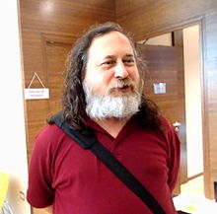
What is FOSS?
Free was defined by Richard Stallman in 1985, as four essential freedoms:
0 – Run the program as you wish, for any purpose.
1 - Study how the program works, and adapt it to your needs. *
2 - Redistribute copies so you can help your neighbor.
3 - Improve the program, and release your improvements to the public, so that the whole community benefits. *
*Access to the source code is a precondition for this.
Notes:
Richard Stallman, the founder of GNU (1983) created the GNU manifesto and FSF in 1985 upon these 4 essential freedoms.
Basically he is the “father” of FOSS.

Slide 4



FOSS vs non-free OSS
Aren’t all Open Source software free?
No!
Examples:
Truecrypt
Unreal Engine
NASA Projects (https://github.com/nasa)
Notes:
Free as חופשי
And not as חינמי
לא להכנס עדיין לפרטים על הרישיונות

Slide 5



Hardware Projects
Examples:
Arduino
Pixhawk
UltiMaker
Raspberry Pi (not entirely OS)

Slide 6

FOSS History- The GNU Project
GNU’s not Unix!
Founded at 1983 by Richard Stallman, aimed to provide a free Unix-like (but not Unix!) OS.
Developed many OS utilities (gcc, emacs, bash…), but did not complete a working stable OS kernel.
The GNU/Hurd project started in 1990, still being developed, and is still not production ready.
Notes:
Founded by Richard Stallman.
The GNU project is the “Founding Father” of today’s open source.

Slide 7


Linux
The Linux project started by Linus Trovalds in 1991.
Aimed to be a free UNIX-like kernel.
Today, there are more than 15k contributors.
As most GNU projects, Linux is written in C.

Slide 8






First GNU OS
GNU/Linux has emerged
GNU and Linux defined the FOSS world as we know it today.
Multiple flavors of GNU/Linux distributions:
Today it controls mobile, datacenters & IoT.
Notes:
Also mention Android and Linux Embedded. Linux is by far the most popular os in the world.

Slide 9
Open Source Introduction
Definition, terminology & history
License types and their impact
Major players & eco-system

Slide 10






Common FOSS licenses
“Copyleft” Licenses
GPL (v2 & v3)
LGPL
AGPL
“Permissive” Licenses
MIT
BSD
APACHE
Dual License - ?
Notes:
(Next slide is the license comparison grid)
Copyleft, distinguished from copyright, is the practice of offering people the right to freely distribute copies and modified versions of a work with the stipulation that the same rights be preserved in derivative works created later.[1] Copyleft software licenses are considered protective or reciprocal, as contrasted with permissive free software licenses
GPL – You must pass the same freedoms that you received to the software recipient
Permissive – Do whatever you want with basic/simple limitations (such as copyright)

Slide 11
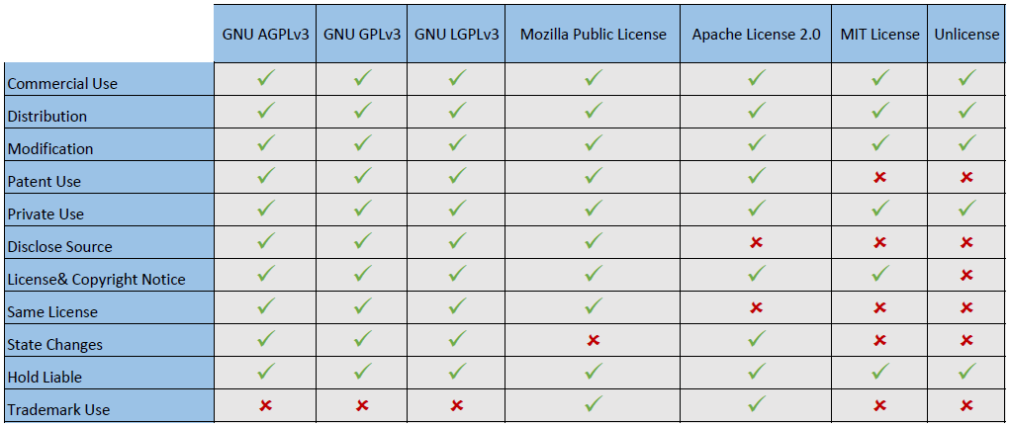
License Comparison Table
More comprehensive list: https://en.wikipedia.org/wiki/Comparison_of_free_and_open-source_software_licenses

Slide 12

GPL
If the modules are included in the same executable file, they are definitely combined in one program. If modules are designed to run linked together in a shared address space, that almost surely means combining them into one program.
By contrast, pipes, sockets and command-line arguments are communication mechanisms normally used between two separate programs.
From the GNU website FAQ
Notes:
GNU GPL (or GPL)

Slide 13
License Compatibility
When you have a BSD licensed project, and you want to use a GPL licensed library, what happens to your project?
And vice-versa?
Is GPL compatible with BSD?
Is BSD compatible with a commercial paid license?
Is GPL compatible with a commercial paid license?
What happens if I released my project as GPL, but now I want it to be changed to commercial?
Notes:
שקופית דיון

Slide 14
Non-Free OSS Licenses
Examples:
NASA Open Source Agreement
TrueCrypt License Version 3.0
Notes:
NASA requires that your contributions will be only your own (limits contribution freedom)
Truecrypt does not allow to sell copies (limits distribution freedom)

Slide 15
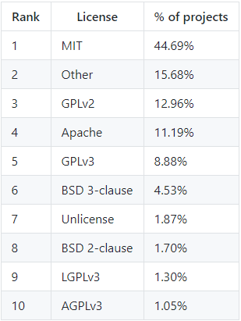
Most popular licenses
License type distribution among Github’s projects:

Slide 16
Open Source Introduction
Definition, terminology & history
License types and their impact
Major players & eco-system

Slide 17







Major players in FOSS
Redhat
Google (Android, TensorFlow)
Facebook (React, Flow, HHVM)
MongoDB
Elastic (Elastic Search, Logstash, Kibana)
Nvidia
Intel, IBM, Microsoft, Etc…
Mozilla, Apache

Slide 18
Why contribute or use FOSS?
Strong communities
Continuous updates & progress
Economical (business models)
High quality
Secure (vs. security through obscurity)
Distributed development
Credits & sense of accomplishment

